Slide 1
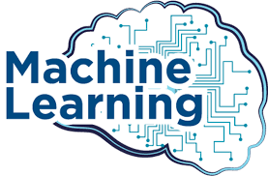
By
Sakin Jan
Lecturer Govt. Postgraduate College Charsadda

Slide 2
What is Machine Learning
Machine learning is an application of artificial intelligence that involves algorithms and data that automatically analyse and make decision by itself without human intervention.
It describes how computer perform tasks on their own by previous experiences.
Therefore we can say in machine language artificial intelligence is generated on the basis of experience.

Slide 3
Normal Computer vs ML
The difference between normal computer software and machine learning is that a human developer hasn’t given codes that instructs the system how to react to situation, instead it is being trained by a large number of data.

Slide 4
Machine Learning Uses:
Traffic prediction
Virtual Personal Assistant
Speech recognition
Email spam and malware filtering
Bioinformatics
Natural language processing

Slide 5
Real Time Examples for ML
TRAFFIC PREDICTION
VIRTUAL PERSONAL ASSISTANT
ONLINE TRANSPORTATION
SOCIAL MEDIA SERVICES
EMAIL SPAM FILTERING
PRODUCT RECOMMENDATION
ONLINE FRAUD DETECTION

Slide 6
Best Programming Languages for ML
Some of the best and most commonly used machine learning programs are
Python,
java,
C,
C++,
Shell,
R,
JavaScript,
Scala,
Shell,
Julia

Slide 7
Difference Between Machine Learning And Artificial Intelligence
Artificial Intelligence is a concept of creating intelligent machines that stimulates human behaviour whereas Machine learning is a subset of Artificial intelligence that allows machine to learn from data without being programmed.

Slide 8
Advantages of Machine Learning
Fast, Accurate, Efficient.
Automation of most applications.
Wide range of real life applications.
Enhanced cyber security and spam detection.
No human Intervention is needed.
Handling multi dimensional data.

Slide 9
Disadvantages of Machine Learning
It is very difficult to identify and rectify the errors.
Data Acquisition.
Interpretation of results Requires more time and space.

Slide 10
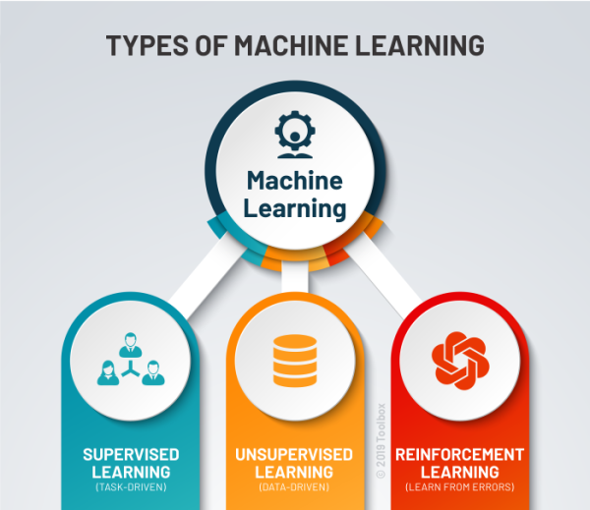

Slide 11
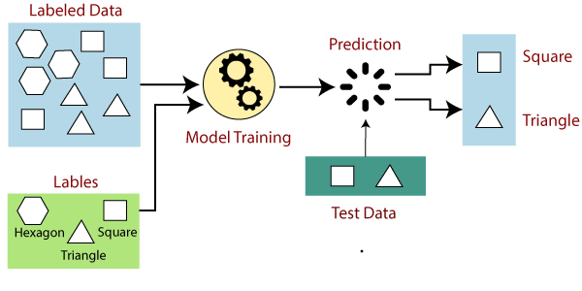

Slide 12
Supervised machine learning
Supervised machine learning is based on supervision.
we train the machines using the "labelled" dataset, and based on the training, the machine predicts the output.
Labelled data specifies that some of the inputs are already mapped to the output.
we train the machine with the input and corresponding output, and then we ask the machine to predict the output using the test dataset.
Suppose we have an input dataset of cats and dog images. So, first, we will provide the training to the machine to understand the images, such as the shape & size of the tail of cat and dog, Shape of eyes, colour, height (dogs are taller, cats are smaller), etc.
After completion of training, we input the picture of a cat and ask the machine to identify the object and predict the output.
Now, the machine is well trained, so it will check all the features of the object, such as height, shape, colour, eyes, ears, tail, etc., and find that it's a cat. So, it will put it in the Cat category. This is the process of how the machine identifies the objects in Supervised Learning.
The main goal of the supervised learning technique is to map the input variable(x) with the output variable(y). Some real-world applications of supervised learning are Risk Assessment, Fraud Detection, Spam filtering, etc.

Slide 13
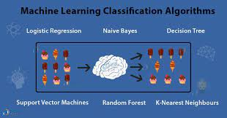
Categories of Supervised Machine Learning
Supervised machine learning can be classified into two types of problems, which are given below:
a) Classification
Classification algorithms are used to solve the classification problems in which the output variable is categorical, such as "Yes" or No, Male or Female, Red or Blue, etc. The classification algorithms predict the categories present in the dataset. Some real-world examples of classification algorithms are Spam Detection, Email filtering, etc.
Some popular classification algorithms are given below:
Random Forest Algorithm
Decision Tree Algorithm
Logistic Regression Algorithm
Support Vector Machine Algorithm

Slide 14
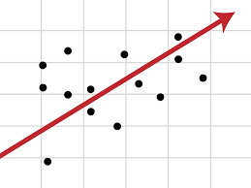
b) Regression
Regression algorithms are used to solve regression problems in which there is a linear relationship between input and output variables. These are used to predict continuous output variables, such as market trends, weather prediction, etc.
Some popular Regression algorithms are given below:
Simple Linear Regression Algorithm
Multivariate Regression Algorithm
Decision Tree Algorithm
Lasso Regression

Slide 15
Advantages and Disadvantages of Supervised Learning
Advantages:
Since supervised learning work with the labelled dataset so we can have an exact idea about the classes of objects.
These algorithms are helpful in predicting the output on the basis of prior experience.
Disadvantages:
These algorithms are not able to solve complex tasks.
It may predict the wrong output if the test data is different from the training data.
It requires lots of computational time to train the algorithm.

Slide 16
Applications of Supervised Learning
Some common applications of Supervised Learning are given below:
Image Segmentation: Supervised Learning algorithms are used in image segmentation. In this process, image classification is performed on different image data with pre-defined labels.
Medical Diagnosis: Supervised algorithms are also used in the medical field for diagnosis purposes. It is done by using medical images and past labelled data with labels for disease conditions. With such a process, the machine can identify a disease for the new patients.
Fraud Detection - Supervised Learning classification algorithms are used for identifying fraud transactions, fraud customers, etc. It is done by using historic data to identify the patterns that can lead to possible fraud.
Spam detection - In spam detection & filtering, classification algorithms are used. These algorithms classify an email as spam or not spam. The spam emails are sent to the spam folder.
Speech Recognition - Supervised learning algorithms are also used in speech recognition. The algorithm is trained with voice data, and various identifications can be done using the same, such as voice-activated passwords, voice commands, etc.

Slide 17
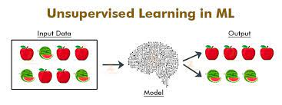

Slide 18
Unsupervised Machine Learning
There is no need for supervision.
The machine is trained using the unlabeled dataset, and the machine predicts the output without any supervision.
In unsupervised learning, the models are trained with the data that is neither classified nor labelled, and the model acts on that data without any supervision.
The main aim of the unsupervised learning algorithm is to group or categories the unsorted dataset according to the similarities, patterns, and differences.
Machines are instructed to find the hidden patterns from the input dataset.
Example suppose there is a basket of fruit images, and we input it into the machine learning model. The images are totally unknown to the model, and the task of the machine is to find the patterns and categories of the objects.
So, now the machine will discover its patterns and differences, such as colour difference, shape difference, and predict the output when it is tested with the test dataset.

Slide 19
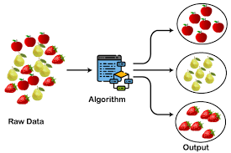
Categories of Unsupervised Machine Learning
1) Clustering
The clustering technique is used when we want to find the inherent groups from the data.
It is a way to group the objects into a cluster such that the objects with the most similarities remain in one group and have fewer or no similarities with the objects of other groups.
An example of the clustering algorithm is grouping the customers by their purchasing behaviour.
Some of the popular clustering algorithms are given below:
K-Means Clustering algorithm
Mean-shift algorithm
DBSCAN Algorithm
Principal Component Analysis
Independent Component Analysis

Slide 20
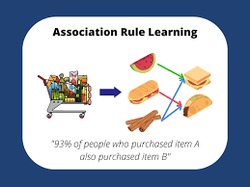
2) Association
Association rule learning is an unsupervised learning technique, which finds interesting relations among variables within a large dataset.
The main aim of this learning algorithm is to find the dependency of one data item on another data item and map those variables accordingly so
that it can generate maximum
profit.
This algorithm is mainly applied
in Market Basket analysis,
Web usage mining, continuous
production, etc.
Some popular algorithms of
Association rule learning are
Apriori Algorithm, Eclat,
FP-growth algorithm.

Slide 21
Advantages and Disadvantages of Unsupervised Learning Algorithm
Advantages:
These algorithms can be used for complicated tasks compared to the supervised ones because these algorithms work on the unlabeled dataset.
Unsupervised algorithms are preferable for various tasks as getting the unlabeled dataset is easier as compared to the labelled dataset.
Disadvantages:
The output of an unsupervised algorithm can be less accurate as the dataset is not labelled, and algorithms are not trained with the exact output in prior.
Working with Unsupervised learning is more difficult as it works with the unlabelled dataset that does not map with the output.

Slide 22
Applications of Unsupervised Learning
Network Analysis: Unsupervised learning is used for identifying plagiarism and copyright in document network analysis of text data for scholarly articles.
Recommendation Systems: Recommendation systems widely use unsupervised learning techniques for building recommendation applications for different web applications and e-commerce websites.
Anomaly Detection: Anomaly detection is a popular application of unsupervised learning, which can identify unusual data points within the dataset. It is used to discover fraudulent transactions.
Singular Value Decomposition: Singular Value Decomposition or SVD is used to extract particular information from the database. For example, extracting information of each user located at a particular location.

Slide 23
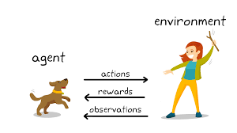

Slide 24
Reinforcement Learning
Reinforcement learning works on a feedback-based process, in which an AI agent (A software component) automatically explore its surrounding by hitting & trail, taking action, learning from experiences, and improving its performance.
Agent gets rewarded for each good action and get punished for each bad action; hence the goal of reinforcement learning agent is to maximize the rewards.
In reinforcement learning, there is no labelled data like supervised learning, and agents learn from their experiences only.
Example, a child learns various things by experiences in his day-to-day life.
An example of reinforcement learning is to play a game, where the Game is the environment, moves of an agent at each step define states, and the goal of the agent is to get a high score. Agent receives feedback in terms of punishment and rewards.
Due to its way of working, reinforcement learning is employed in different fields such as Game theory, Operation Research, Information theory, multi-agent systems.
A reinforcement learning problem can be formalized using Markov Decision Process(MDP). In MDP, the agent constantly interacts with the environment and performs actions; at each action, the environment responds and generates a new state.

Slide 25
Categories of Reinforcement Learning
Reinforcement learning is categorized mainly into two types of methods/algorithms:
Positive Reinforcement Learning: Positive reinforcement learning specifies increasing the tendency that the required behaviour would occur again by adding something. It enhances the strength of the behaviour of the agent and positively impacts it.
Negative Reinforcement Learning: Negative reinforcement learning works exactly opposite to the positive RL. It increases the tendency that the specific behaviour would occur again by avoiding the negative condition.

Slide 26
Real-world Use cases of Reinforcement Learning
Video Games: RL algorithms are much popular in gaming applications. It is used to gain super-human performance. Some popular games that use RL algorithms are AlphaGO and AlphaGO Zero.
Resource Management: The "Resource Management with Deep Reinforcement Learning" paper showed that how to use RL in computer to automatically learn and schedule resources to wait for different jobs in order to minimize average job slowdown.
Robotics: RL is widely being used in Robotics applications. Robots are used in the industrial and manufacturing area, and these robots are made more powerful with reinforcement learning. There are different industries that have their vision of building intelligent robots using AI and Machine learning technology.
Text Mining Text-mining, one of the great applications of NLP, is now being implemented with the help of Reinforcement Learning by Salesforce company.

Slide 27
Advantages and Disadvantages of Reinforcement Learning
Advantages
It helps in solving complex real-world problems which are difficult to be solved by general techniques.
The learning model of RL is similar to the learning of human beings; hence most accurate results can be found.
Helps in achieving long term results.
Disadvantage
RL algorithms are not preferred for simple problems.
RL algorithms require huge data and computations.
Too much reinforcement learning can lead to an overload of states which can weaken the results.
The curse of dimensionality limits reinforcement learning for real physical systems.

Slide 28
Thank you

